Slide 1
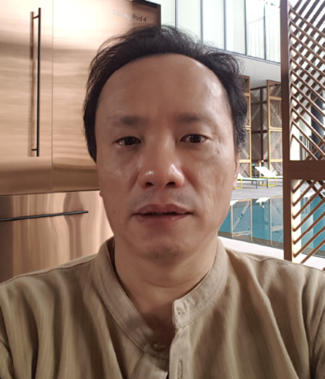
API-T-DROID
Project Codename:
Suggested Pronounciation: EPIC DROID
Jiunn@2021 Tinker, Thinker, Thunker
GoSchool Batch 2
Project Go Live

Slide 2
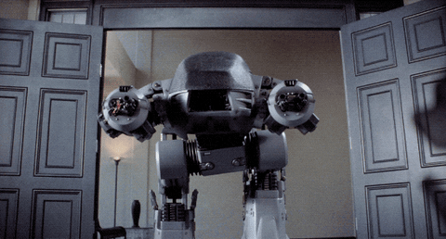
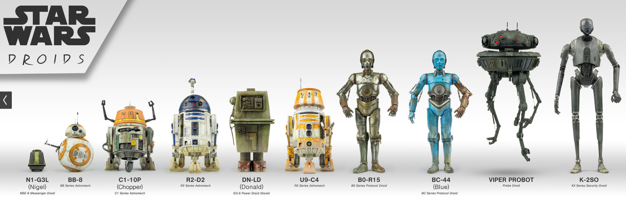
API-T-DROID
EPIC DROID
ED209(Enforcement Droid, RoboCop)
Notes:
When one see the word droid, some may think of these... which is not wrong, as there is the security bot, the probing bot.

Slide 3
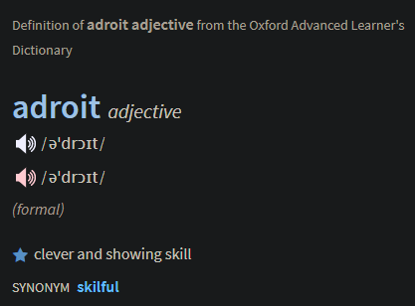
API-T-DROID
A Droid that is
An Adroit Tool In
API Testing
Users’ Epics
Notes:
what is API-T-DROID? It is .... A...DROID, & EPIC (APIT-T sounds EPIC), and again it is a tool to test users’epics.

Slide 4
Agenda - A Technology Preview
Background & History ....................... (3m)
Demo & Walkthrough Current ....................... (6m)
Future Plans ........................ (6m)
Q&A
Notes:
time plan, the background and history though not technical, but is part of the process to discover the features needed.

Slide 5
SELF-SWOT
STRENGTHS
Delivered many projects across industries such as logistics, travel, finance
Good in Solutioning/C#
BG: Philosophy/Physics/Programming
WEAKNESSES
No QA Certifications
Not JS Dev
Not CSS Guru
cHan Solo, Let’s GO
S
W
New ‘Go-Lang-er’ about ready to ‘come down the mountain’
Oppo to GoToMarket with this product
OPPORTUNITIES
Many Sharks Out There
Take “Umbrage” to be Glided to code a Sort Algo in 10 mins.
THREATS
O
T
Notes:
i will take umbrage

Slide 6
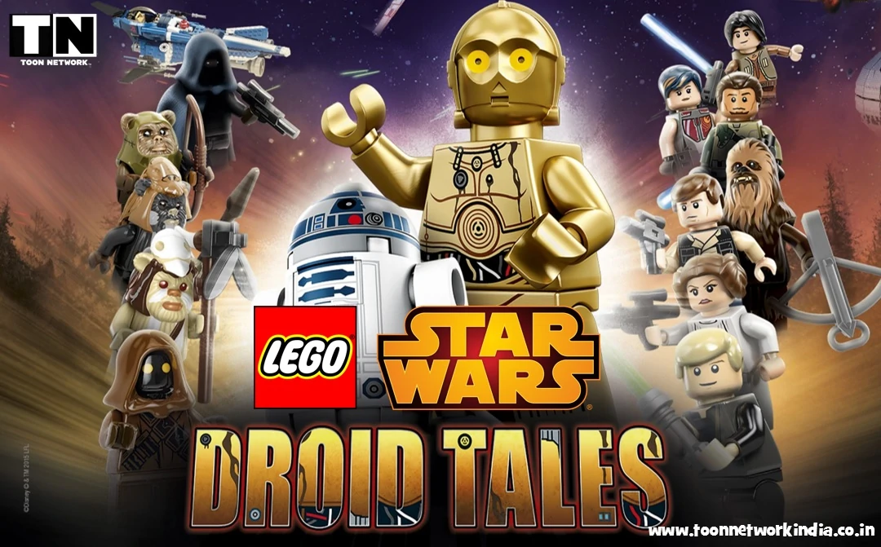
1.
Background
So let the
begin:

Slide 7
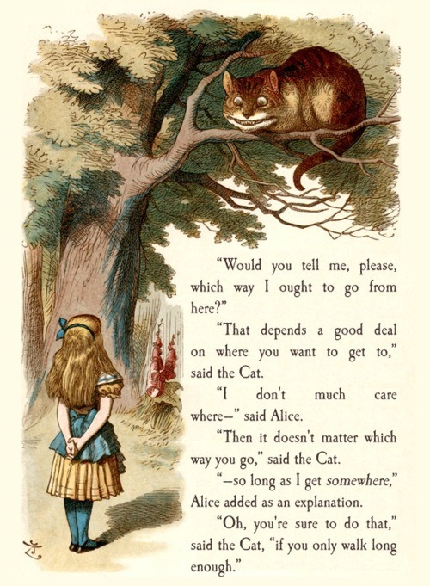
Short History
Notes:
A bit of history so that we know where we are going to get to the scope and objective

Slide 8
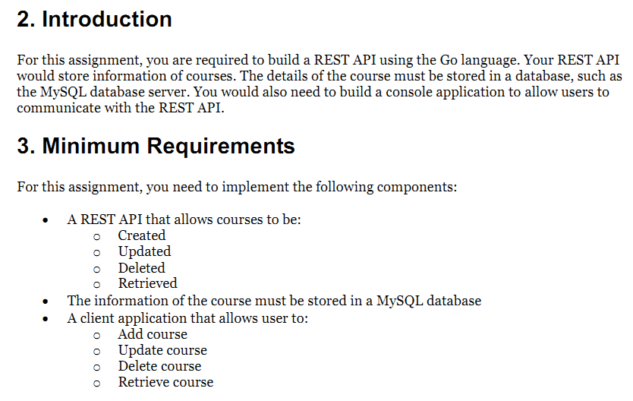
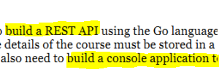
Assignment: Microservices
Notes:
How did the idea came about.? it is from the last assignment, this idea was sprung.

Slide 9
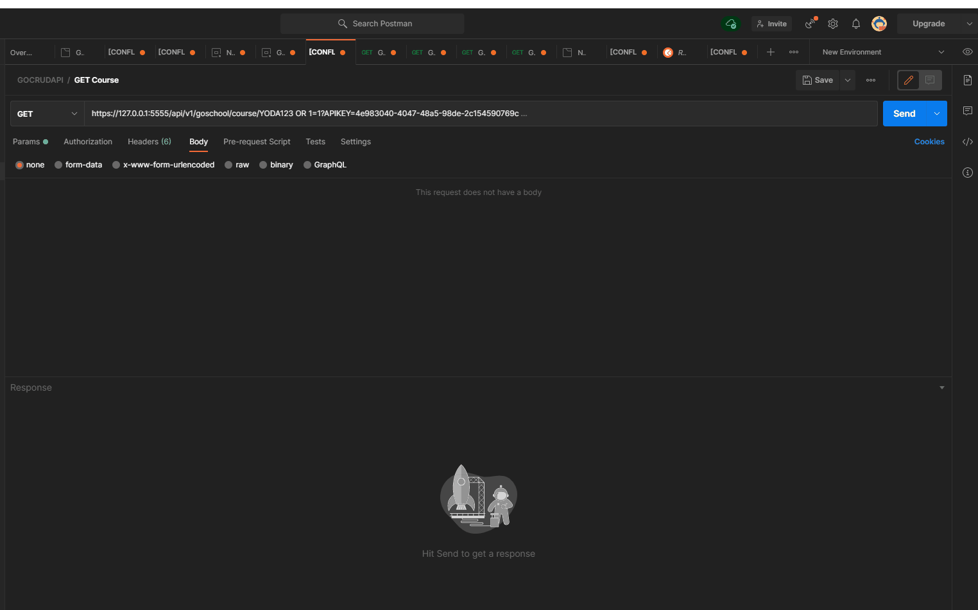
Once Upon A Time ...

Slide 10
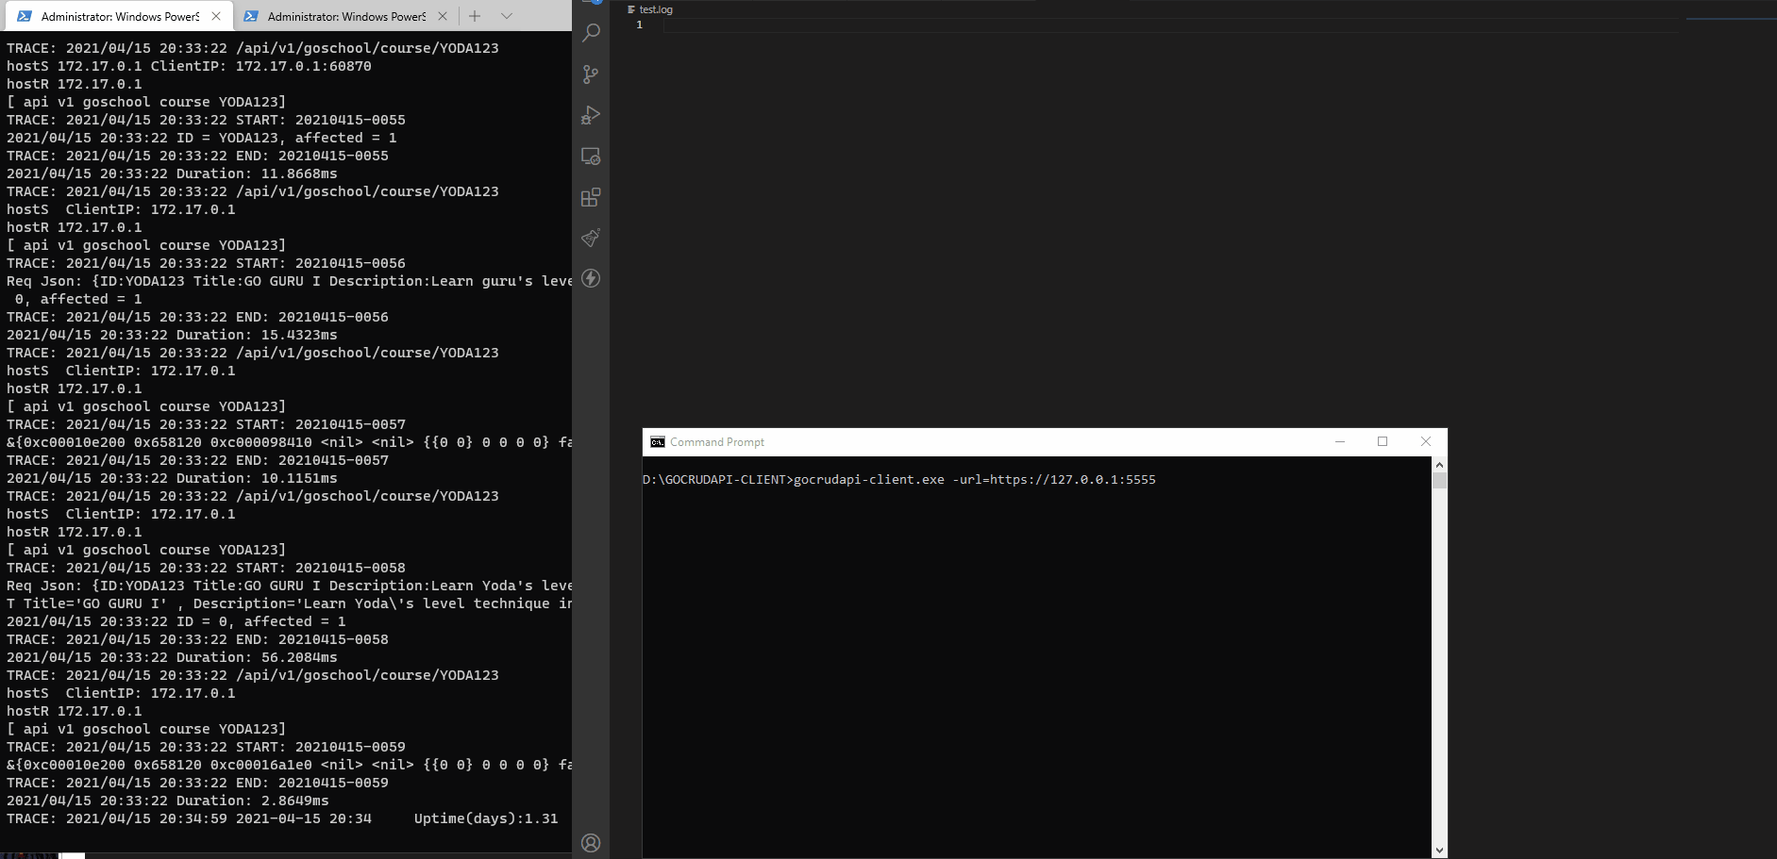
Some Days Later...
Notes:
Decided to build a console client, that can take scripts to execute,
By then it was already mid way thru, so was relatively risky.

Slide 11
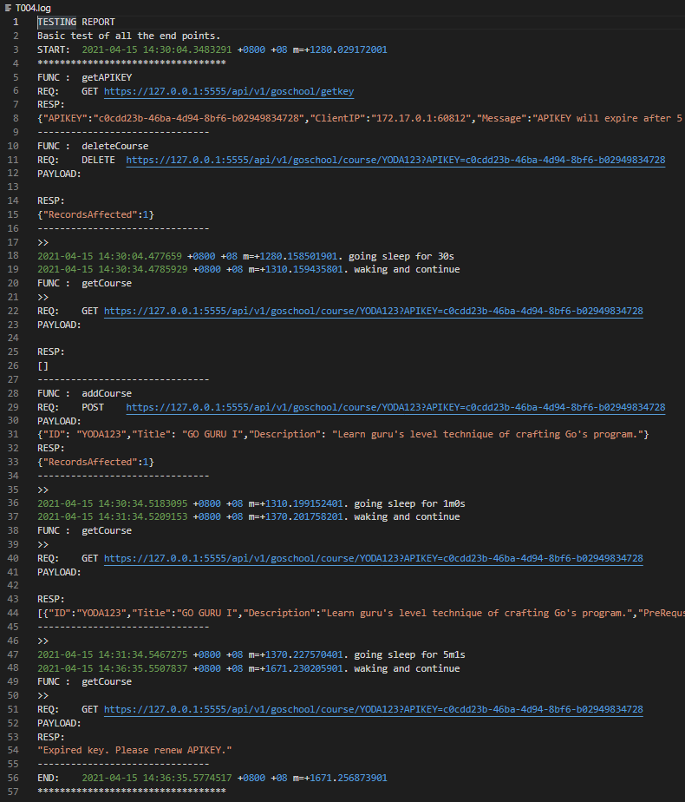
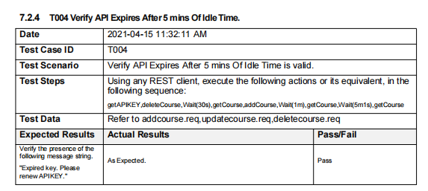
Manual Test vs Auto
Notes:
compare manual vs using the tool
productivity increase
better quality of testing, better coverage

Slide 12
Solved a pain point.
Increased productivity
More coding time
Less time on testing
Increased quality
Better coverage
So
What Happened?
Notes:
basically was helpful, increase productivity and quality
spent less time on testing, and more on coding

Slide 13
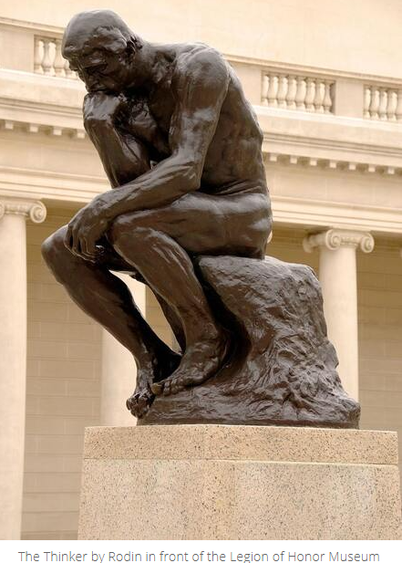
IDEA:
Can this be ‘productized’?
Is there anyone who needs this?
Is there already a solution?
Notes:
thinking wider

Slide 14
2.
Product Research & Ideation
Are there people with similar problems?
User Research
Market Research
Industry Research
Notes:
So previous was personal, a micro-perspective. let do some other research to allow feature discovery
in real world, this would be the Pre-Engineering phase,

Slide 15
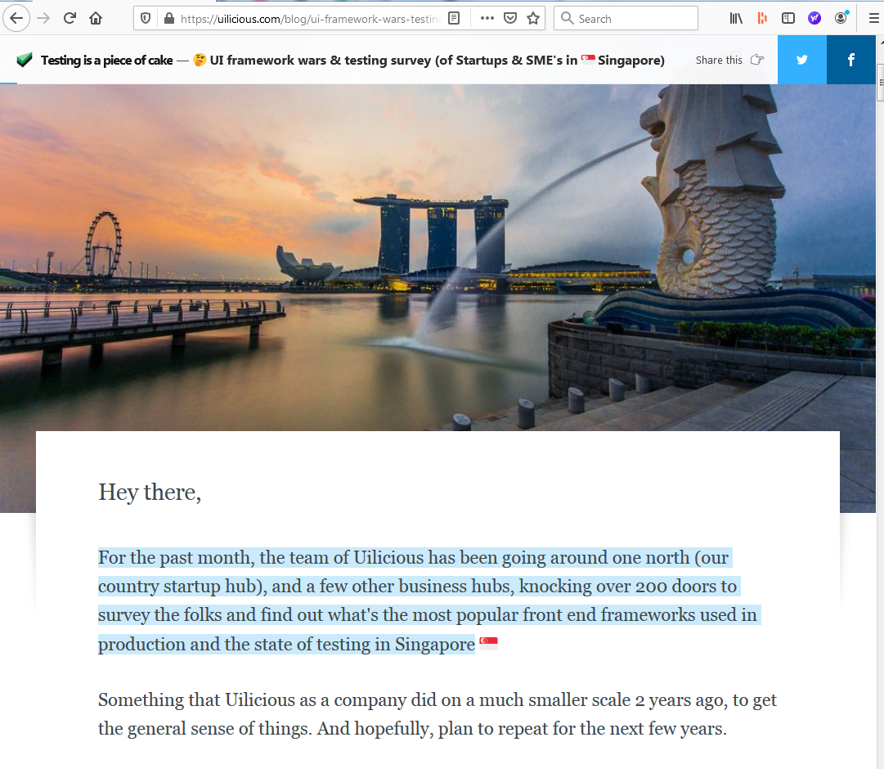

User Research
The following slides summarizes some of their findings:
https://uilicious.com/blog/ui-framework-wars-testing-survey-of-startups-smes-in-singapore/
Notes:
after some search, found a survey done by this startup, doing UI testing in singapore.
Taking points from his survey,
though dated but still relevant.

Slide 16
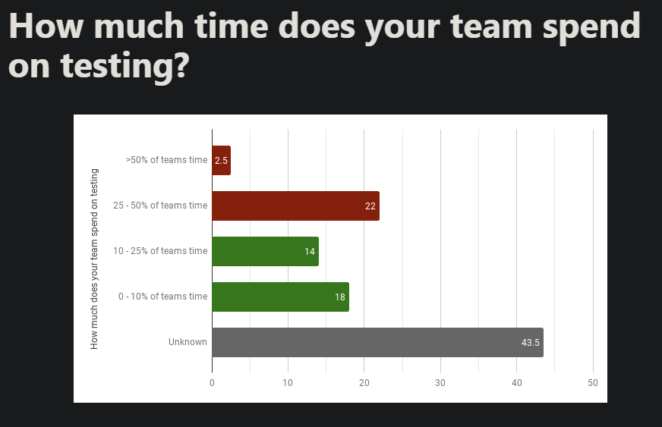
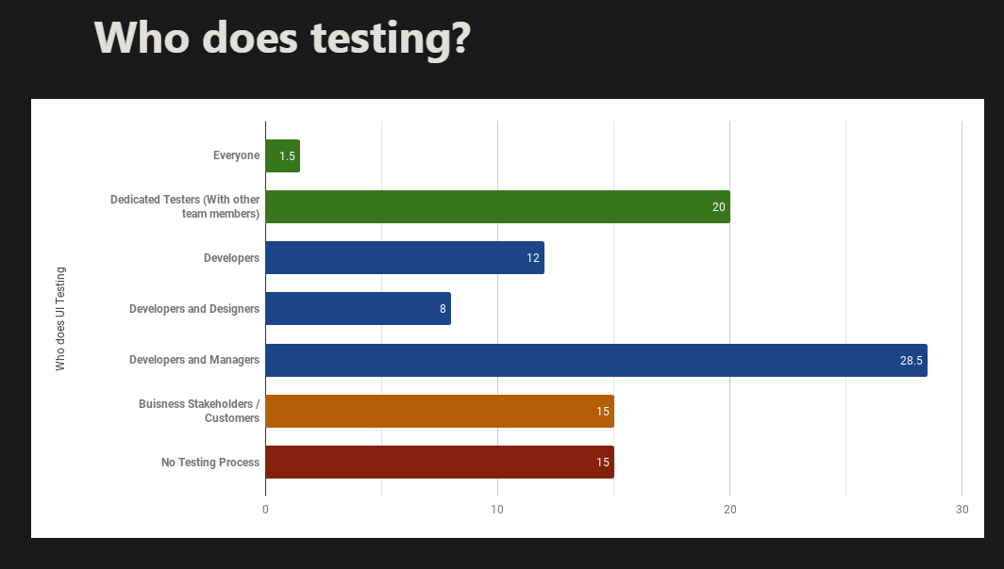
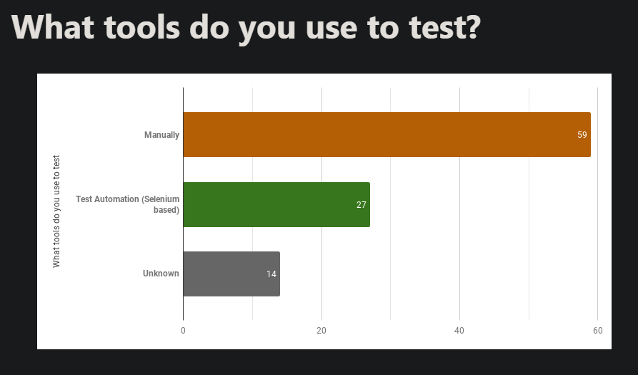
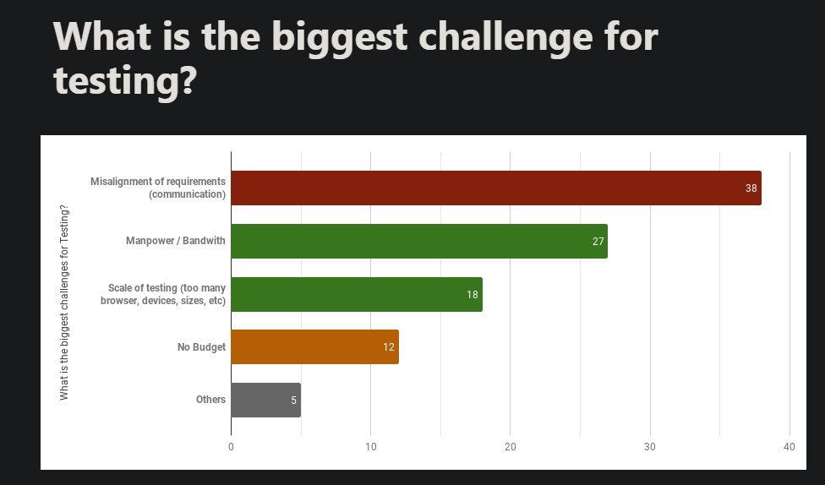
Summary Findings
Developers are typically not a good testers of their own code
22% responded they spent up to 50% of time testing
59% do manual testing
The biggest problem is mis-alignment of requirements.

Slide 17
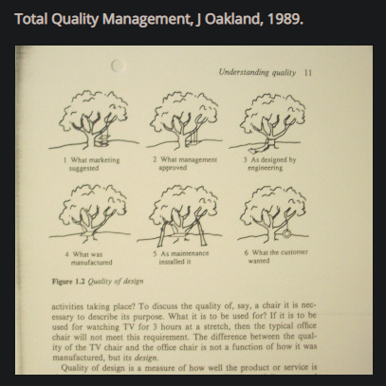
In Summary: The Testing Scence
Some observations
many teams do manual testing, and only on new features, without any regression testing.
some do no testing.
individual companies may differ, but this could be generally true
Without testing, we cannot have a good product.
Earlier versions was said to be the basis of the above ‘Original Tree Swing’ cartoon.
Notes:
It also gives an idea of the Direction that the Features a Testing Tool should have.
Thus, from a bottoms-up research approach, we now have a better idea of the direction we can fo.

Slide 18
3.
Macro
Tales from the Big Picture
Notes:
We now look at some industry trends

Slide 19
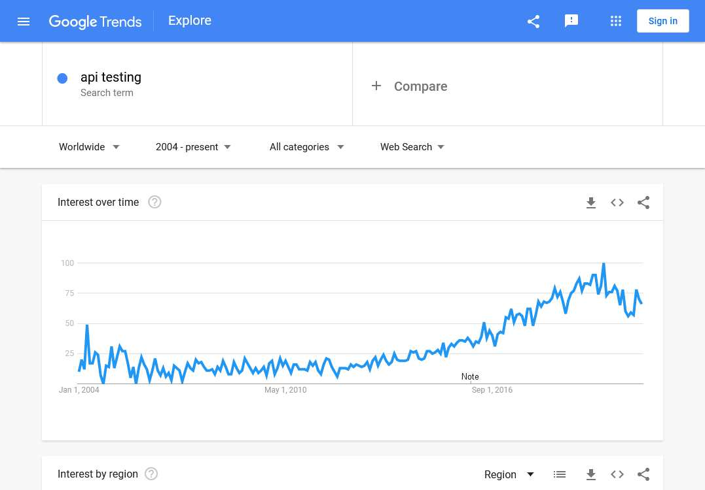
generally up uptrending
Notes:
generally rising

Slide 20
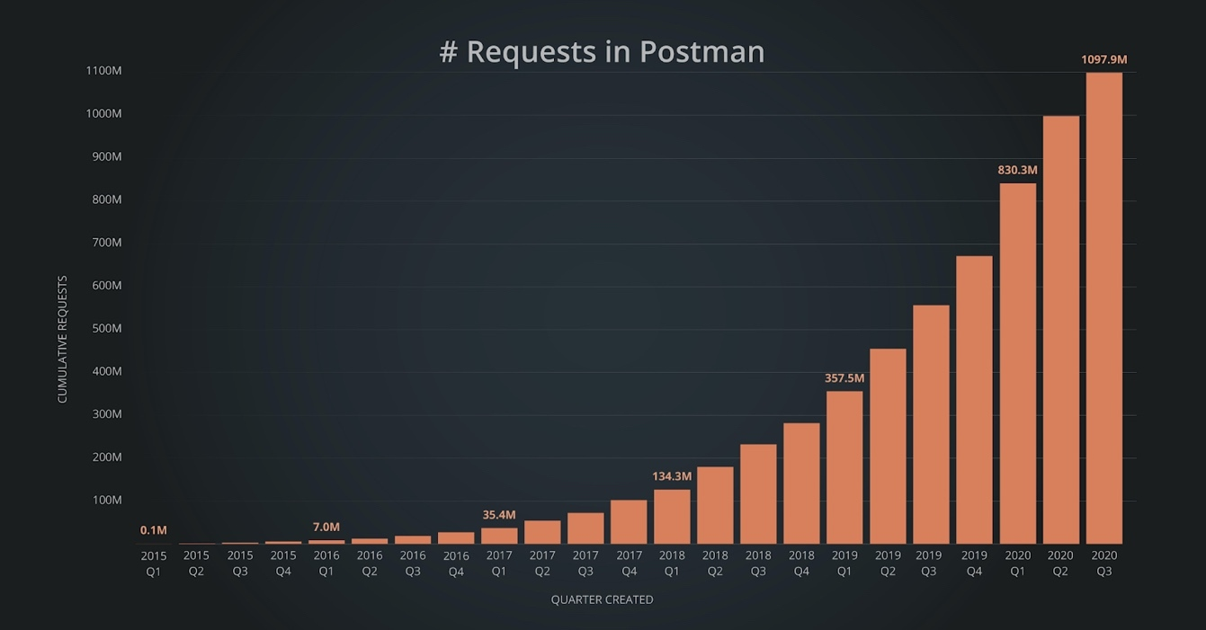
Postman has powered more than 1 billion API requests in 2020 Q3.
https://www.businesswire.com/news/home/20200902005256/en/Postman-Launches-New-Web-Client-to-Simplify-API-Development
Notes:
it seems a lot of folks are interested in having a tool, having similar problems

Slide 21
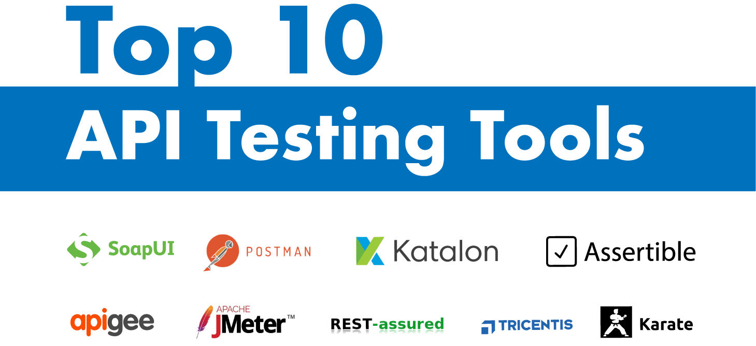
Some are new names, quite a number are old names.
Most names not well known outside of industry
No tool fits all needs.
https://medium.com/@alicealdaine/top-10-api-testing-tools-rest-soap-services-5395cb03cfa9
Notes:
taking a look at what’s out there, maybe the problem is already solved.

Slide 22
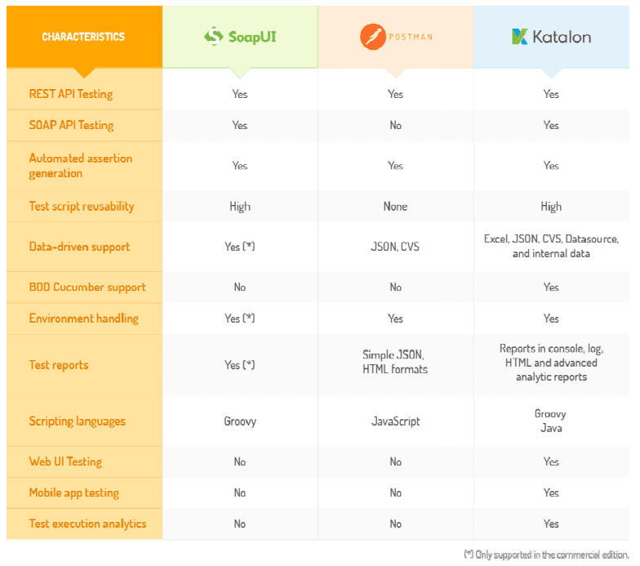
Comparing popular features for benchmarking and understanding what features the market wants
Required for Product Positioning
https://medium.com/@alicealdaine/top-10-api-testing-tools-rest-soap-services-5395cb03cfa9
Notes:
their features

Slide 23

So you wanna build an API-TESTING-DROID?

Slide 24
4.
Product Planning
Tales from the Big Picture

Slide 25
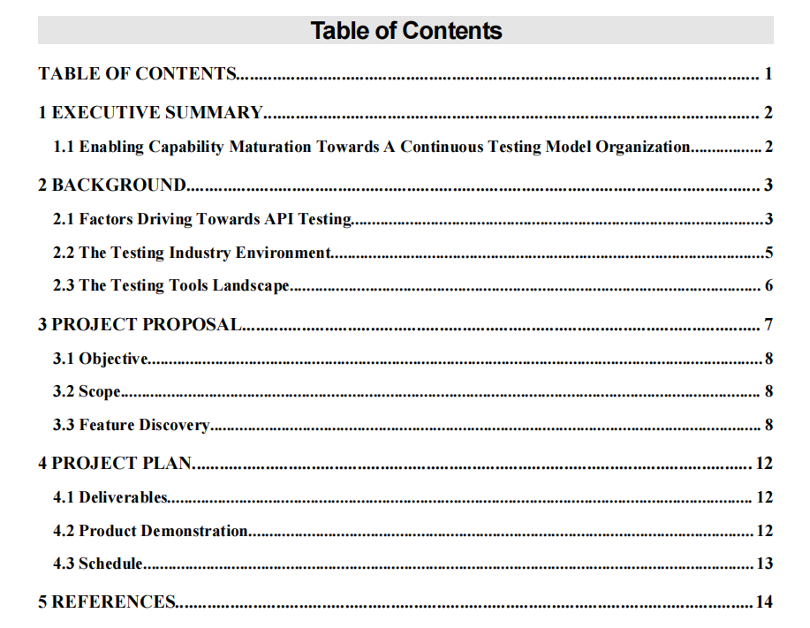
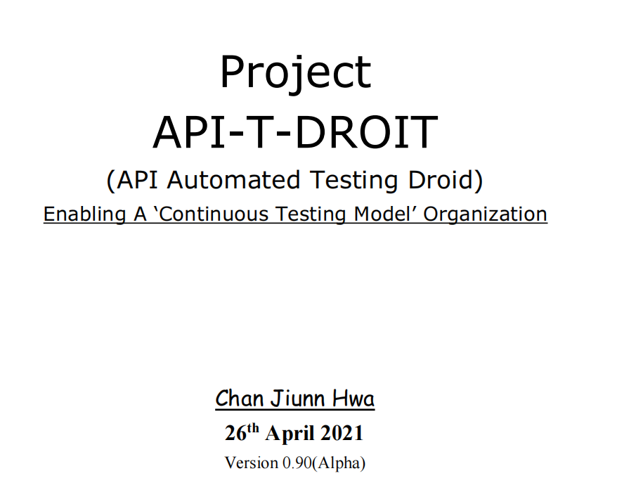
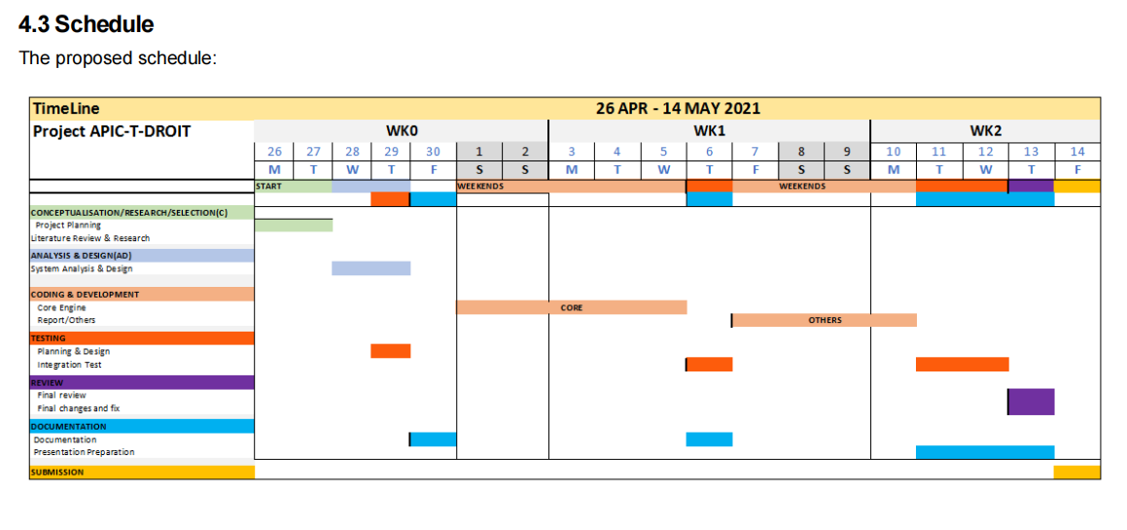

Notes:
proposed schedule

Slide 26
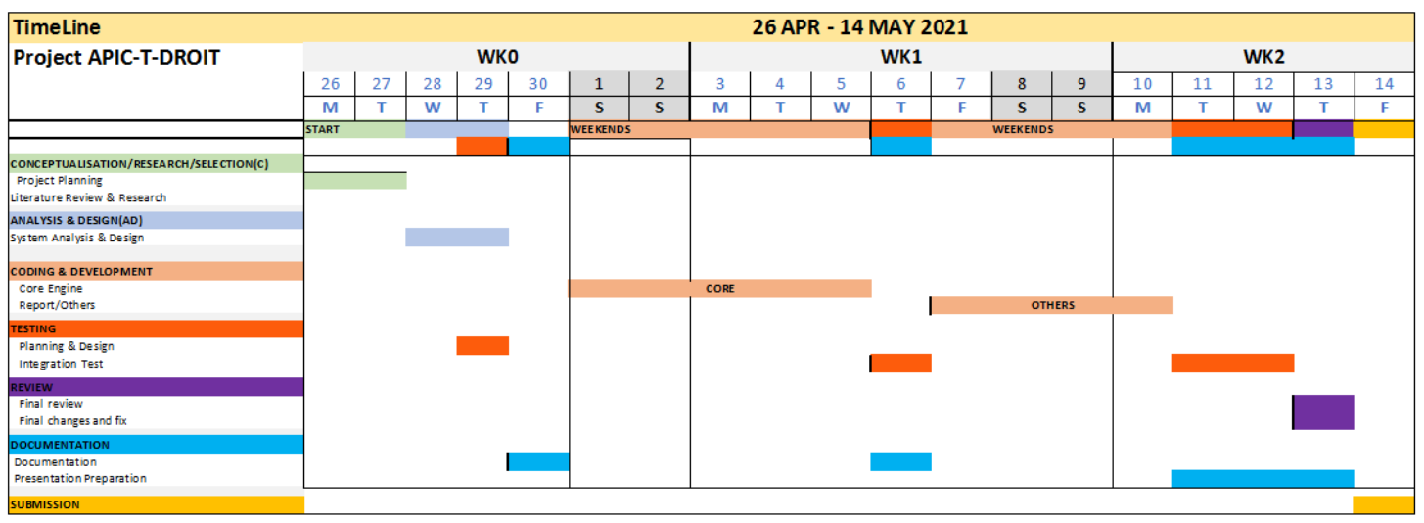
Work Plan Detailed View
Notes:
seems duplicate... will remove this or the other

Slide 27
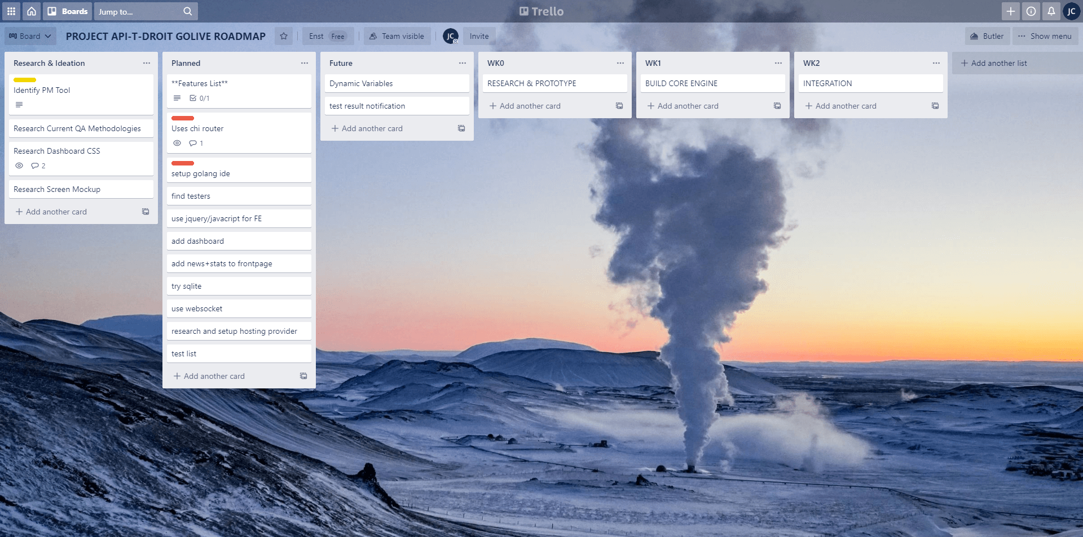
Product Research and Dev Planning
Notes:
ideas from wk0, ideation, after all the research, 2 days

Slide 28
Process Timeline Stack
New Process & Technolgy Injection
Go-Land IDE(Tooling)
Trello (PM)
SQLite (Technology)
User & Stats
Ngrok
WK0
WK1
WK2
Research
Conceptualization
Planning
Prototyping
Development Phase
‘SCRUM’
Integration Phase
Debugging
Testing
Documentation
Notes:
TBD - wants to show some high level scrum timelines
besides product feature, process and technology feature added to timeline, normally a cycle will have up to 20% of something new.

Slide 29




Tech Stack
WebSockets
WebSockets
HTML
BootStrap
CSS
HTML
BootStrap
CSS
Go Routines
Mutex
Closure
Templates
Jquery
Javascript
Go-Lang
Jquery
Javascript
REST API
JSON
HTTPS
Logging
Panic
Error Handling
MySQL
SQLite

Slide 30
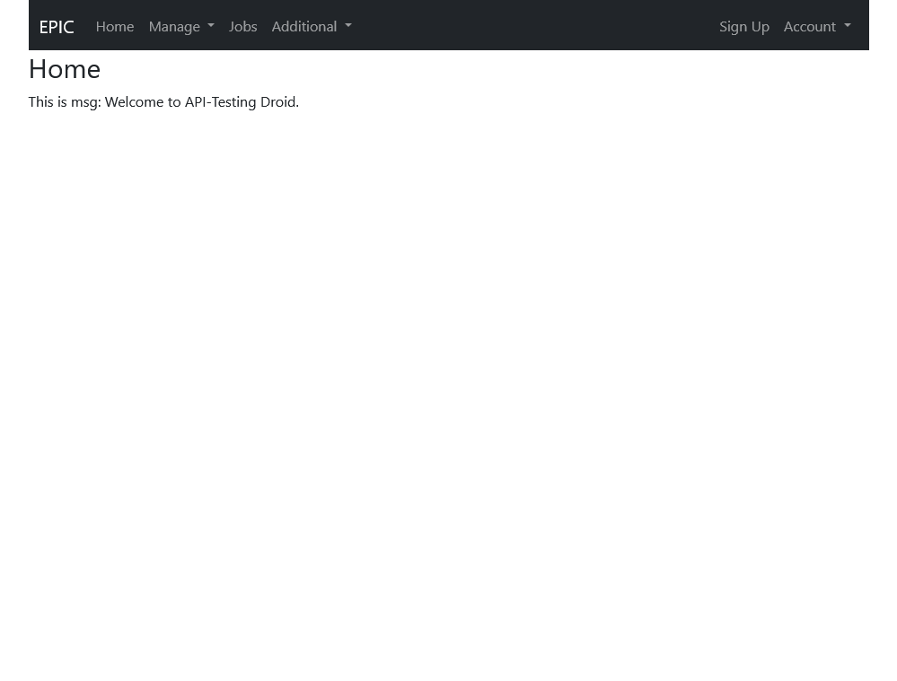
Current Menu and Features
End Points
Test Case
Test Epic
Performance Test
Security Test(TBD)
Broken Links Checker(TBD)
Fuzzing(TBD)
etc ...
Create Test Job
Run Test Job
Notes:
features description and orientation of the system

Slide 31
User Work Flow(Steps and Roles)
SETUP
EXECUTE
Create EndPoint
Create TestJob
Create Test Case
Run TestJob
Create Test Epic
Notes:
Roles can be separated

Slide 32
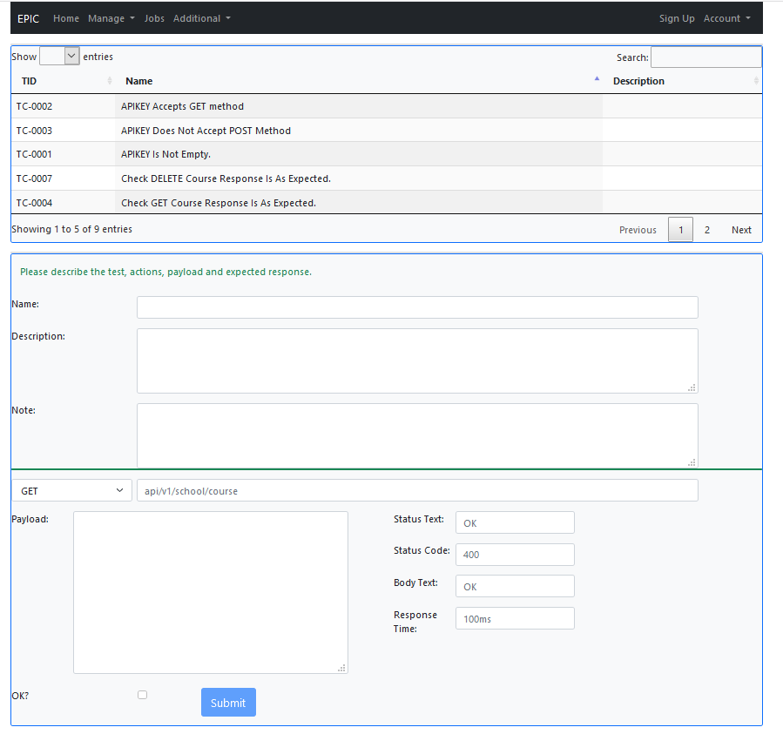
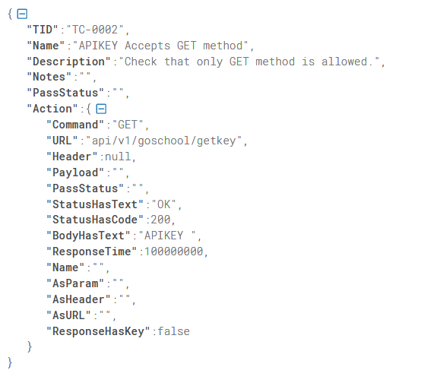
Manage Test Case Screen To JSON

Slide 33
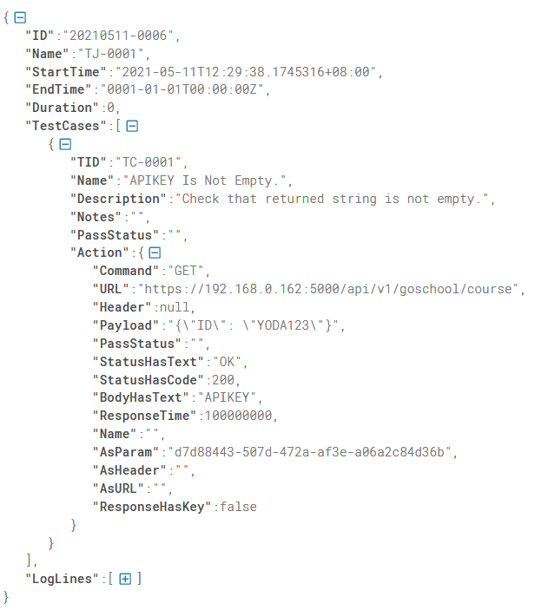
Message Composition, Process Flow & Core Engine
Test Job
Test Case
Web Front
Process Workflow
End Point
Core Engine
Notes:
features description and orientation of the system
happy face if all 3 coopertate

Slide 34


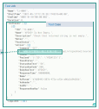
System Diagram
EPIC
Other
Services
Test Responses
Test
Execution
Services
Test Actions

Slide 35
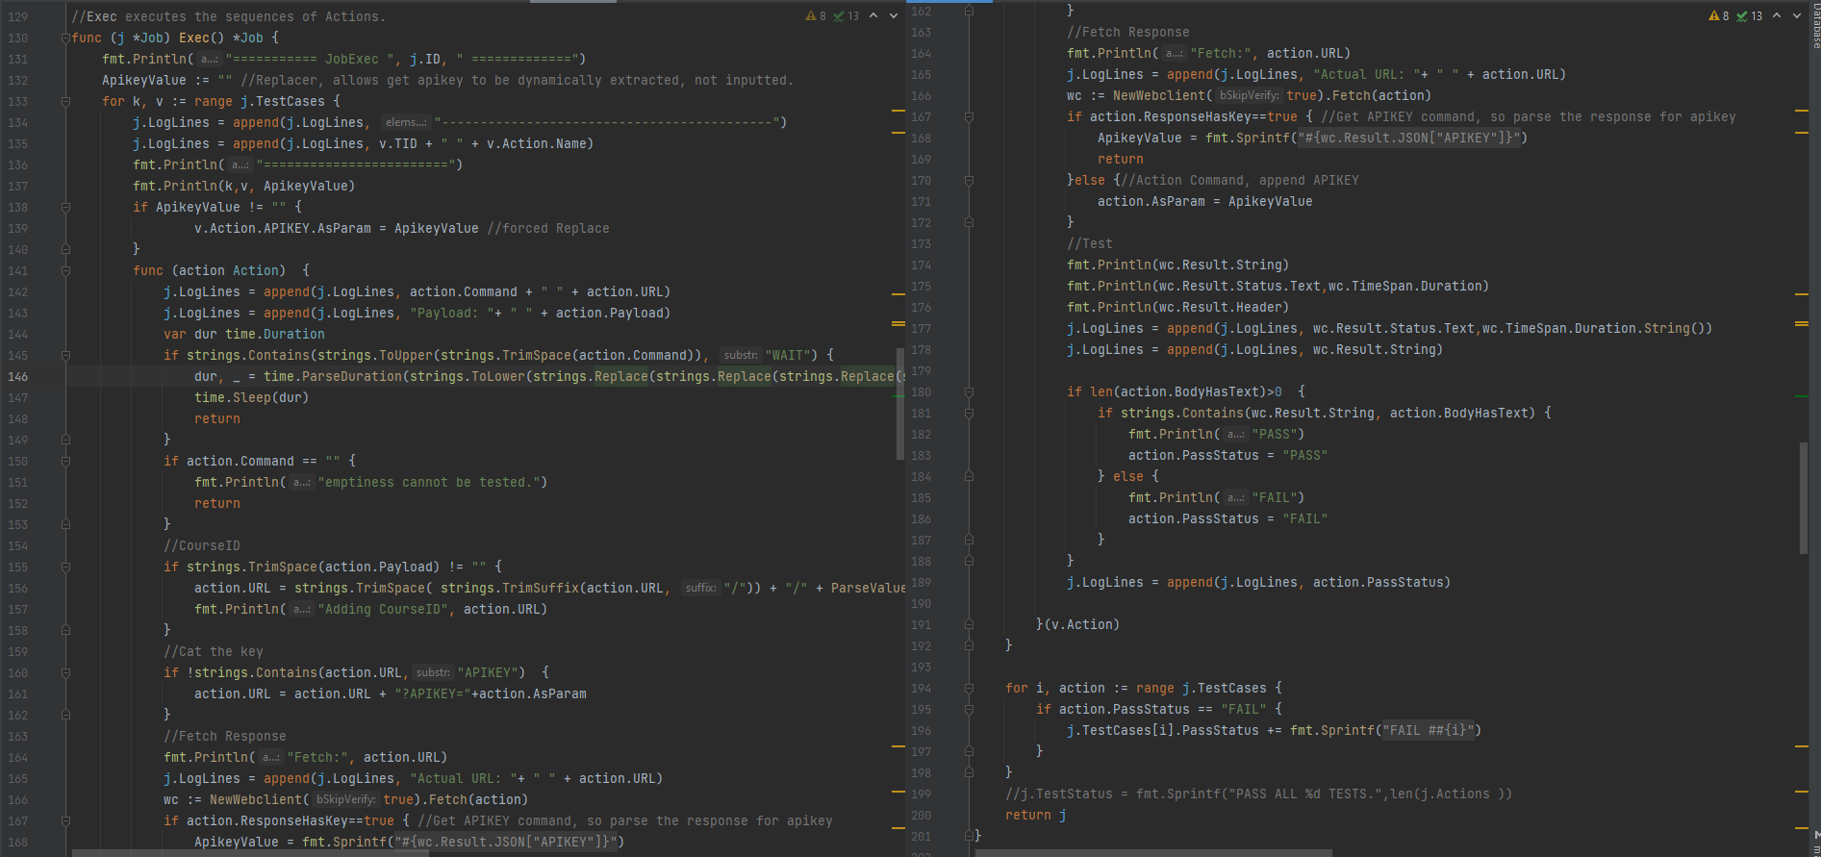
Core Engine

Slide 36
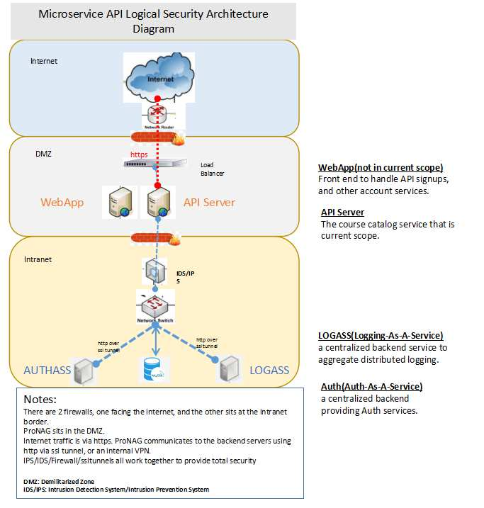
Entreprise Architecture

Slide 37
5.
Demo Time
Notes:
TBD

Slide 38
Demo Scenarios
Set Up EndPoint (RECORDING)
Set Up Test Case, Test Epic(RECORDING)
Create Test Job && Exec(LIVE)
Load Test(LIVE)

Slide 39
Some Key Benefits of ‘EPIC-Droid’
Increases Dev/QA productivity
Improves delivery cycle time
Better, richer, and deeper testing scenarios
User friendly, no programming knowedge(JS) needed.
Can do concurrent load testing on an endpoint

Slide 40
Some Key Features of ‘EPIC-Droid’
From Unit Test to Epics
Can append non-functional test, eg Load Test ...
Web Based, no installations needed.
Test cases saved can be reused.
Cron Testing(scheduler)
Pause and Resume test execution(Sleep)

Slide 41
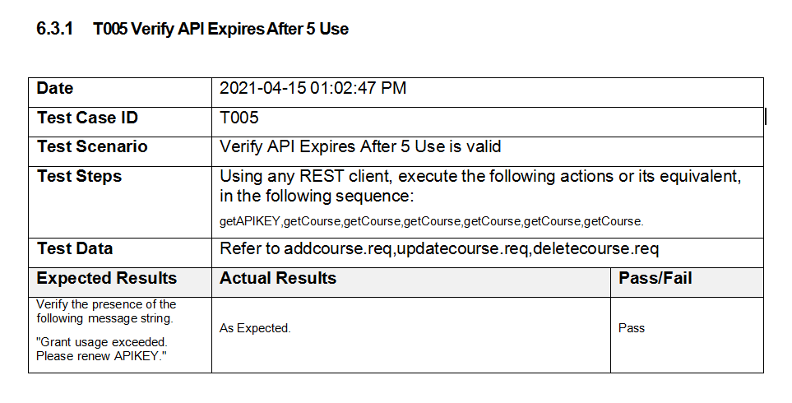
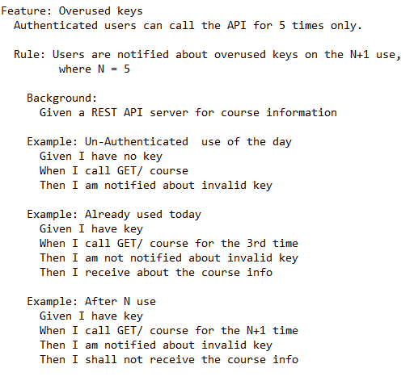
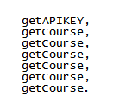
Comparative Advantage of Different Test Specification Method
Traditional
Gherkin Syntax
EPIC Stye

Slide 42
Abstract Scenario Tree
A non-PHD definition:
Abstract: as in abstracted; lifted, reduced, a non-final, intermediate state.
(ps: All abstract states are essentially reduced, as it is abstracted(as opposed to infinite), and is thus only representational and not universal/full/complete/single.)
Scenario Tree: possible branched states due to actions.
A new term invented by Jiunn ’cHan Solo’@20210513
HasBegun
APIKEY
CourseInfo
CourseInfo
CourseInfo
CourseInfo
CourseInfo
Invalid Key
Invalid Key
Hiherto, when we are Testing, what are we actually doing?
We are walking, traversing, asserting a scenario tree.
Thinking in such a Mental Model, will allow new ways to approach Testing, and new Test Tools.

Slide 43
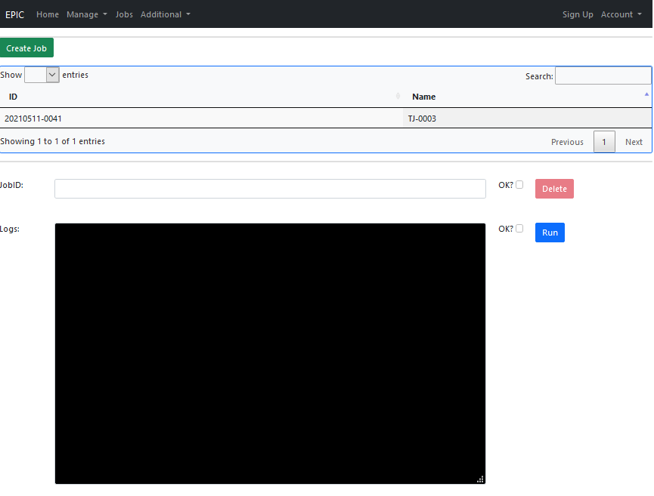
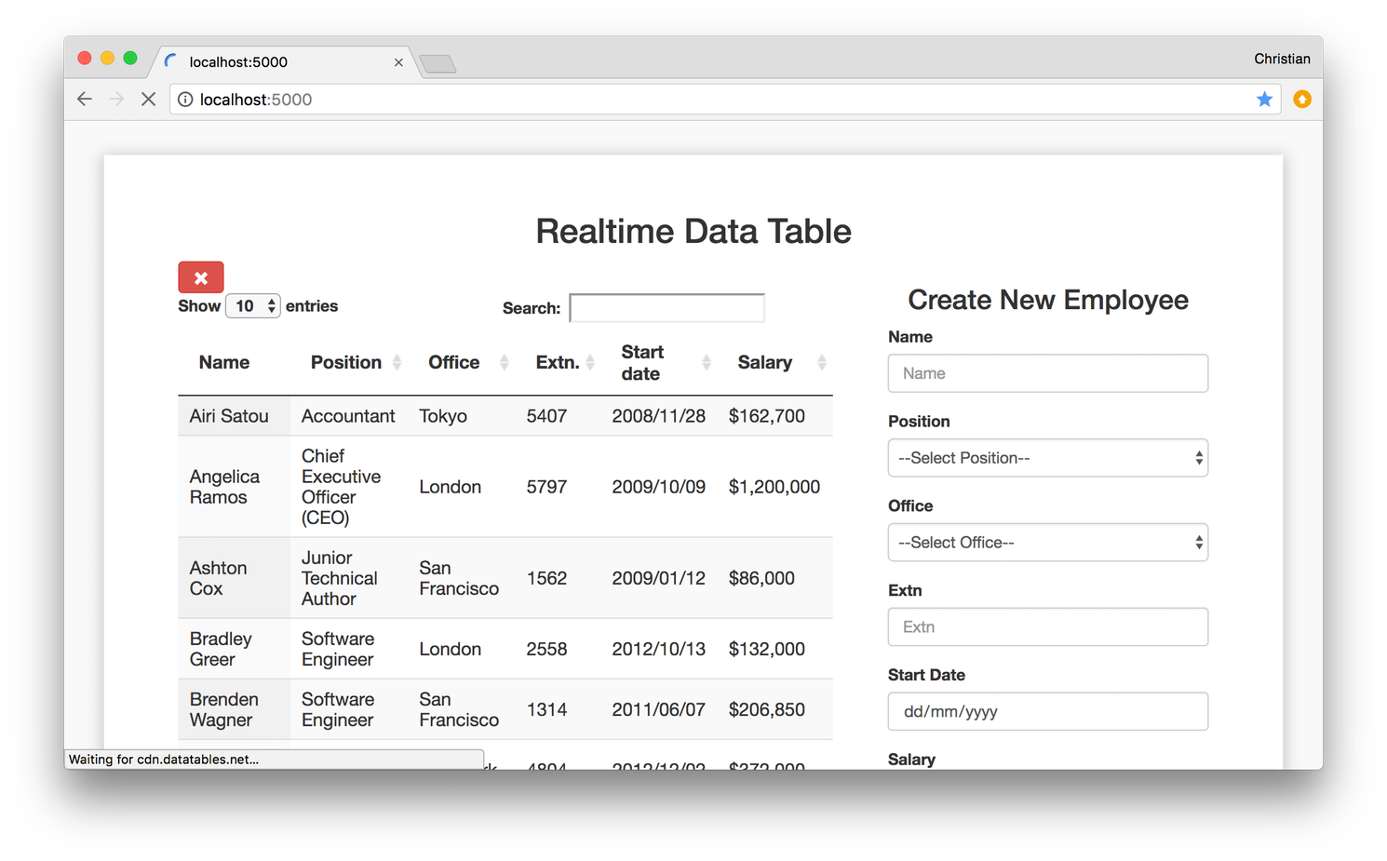
Project Challenges(Examples)
UI
Notes:
took more time

Slide 44
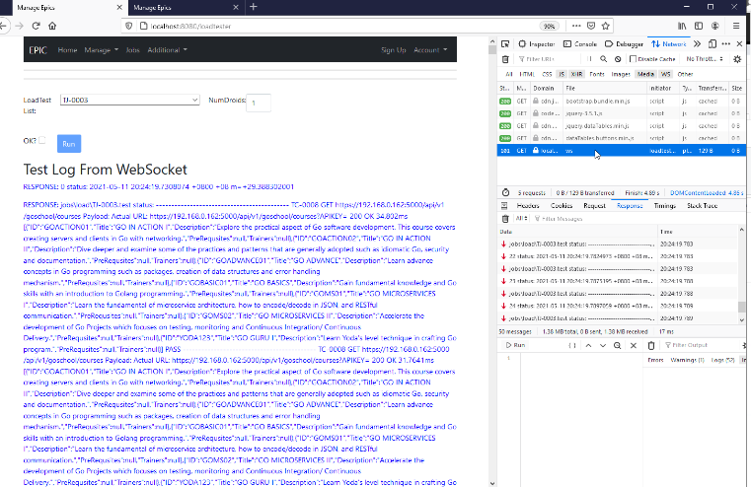
Project Challenges(Examples)
Websockets
Notes:
Ist attempt trying websocket, initially took quite long to debug, then realize it works on GET, whereas this form is POST... manage to solve
if load is too low, by the time the page is returned to browser, it is over, and nothing is shown for example.

Slide 45
Project Limitations
Requires target server to follow textbook REST API URL conventions

Slide 46
6.
Future Plans
What’s next?

Slide 47
RoadMap(Ideas)
UI - colors, process flow, etc.
Response Parsing with Regex/Custom Func
Universal Message Format
Entreprise Versioning(Orgs,Teams,Projects,Users)
SDLC integration
QA Lifecycle integration
Concurrent Actor Model/Distributed Model
Extend to Web(eg. selenium) and mobile

Slide 48
Next Phase(Immediate Tasks)
Partner with Alpha Users to deepen the features
Partner with QA into Testing Lifecycle.
UI changes
Message and Engine enhancements.

Slide 49
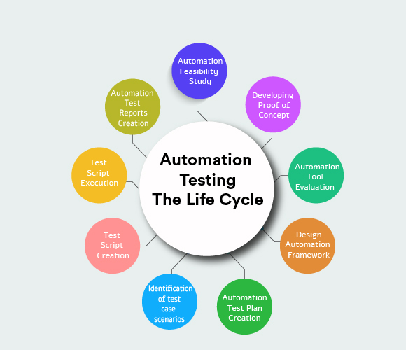
Closer Integration with the QA Cycle
Eg. Skeletal test cases created at Project Inception
Parallel test case development
https://www.appventurez.com/blog/why-should-companies-switch-to-automation-testing/

Slide 50
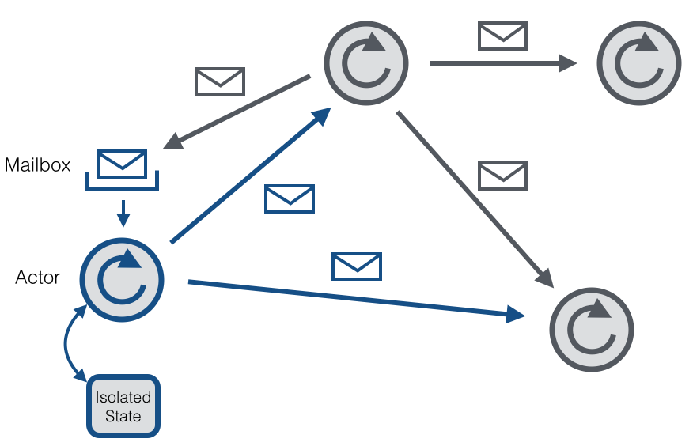
Adopting An Actor Model to Distributed Testing
More Resilent
De-coupled
Distributed & true concurrent load test
https://cwiki.apache.org/confluence/display/FLINK/Akka+and+Actors
Notes:
The Droids
this model is concurrent, more resilent and decoupled, yet orchrestated
message passing

Slide 51
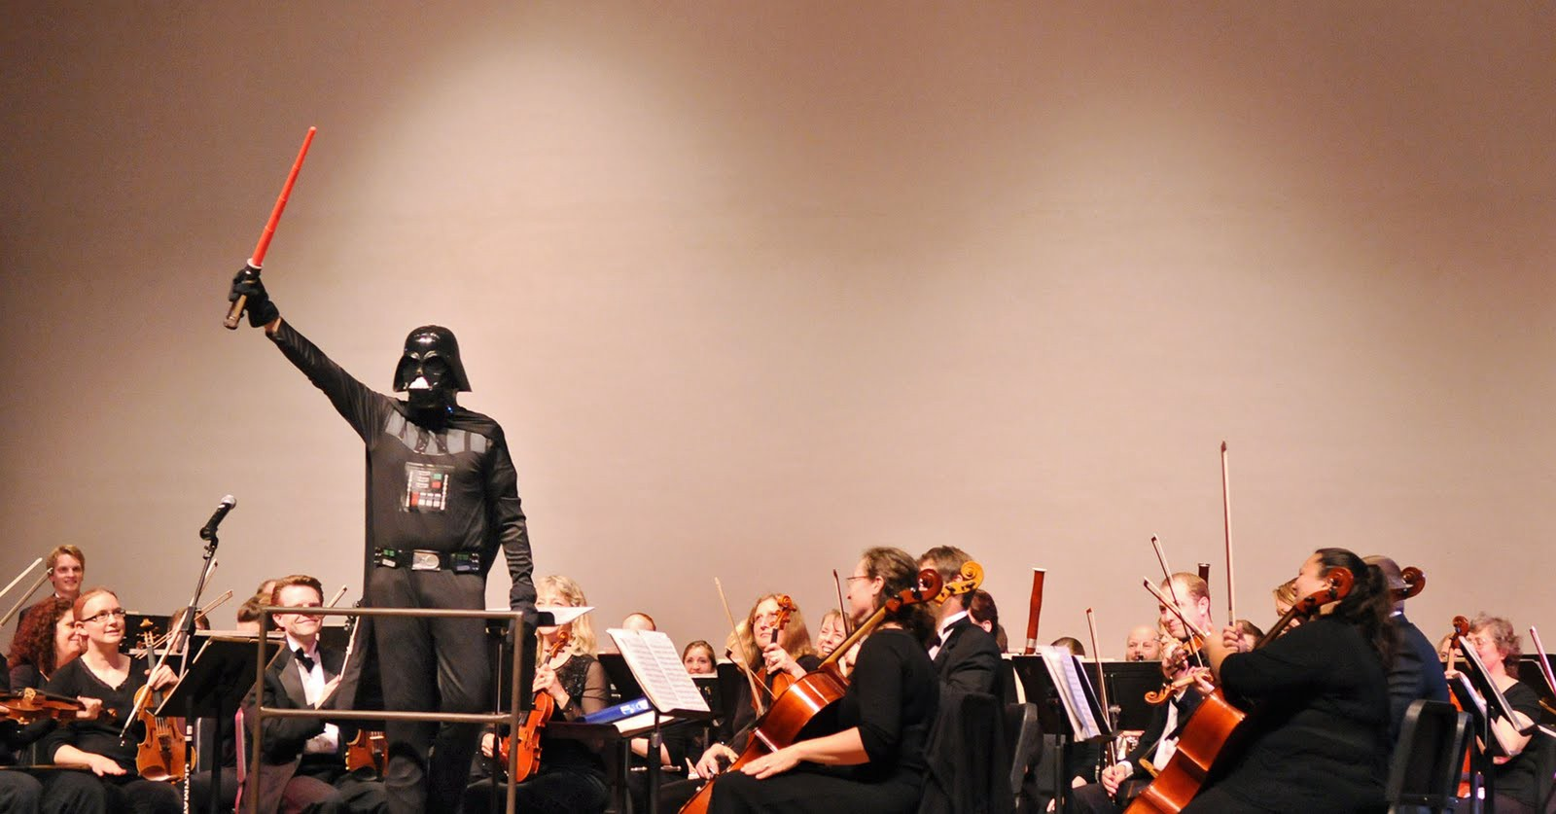
The Droid-Chief As Orchestrator
https://medium.com/@sergiis/actor-model-hidden-in-plain-sight-the-era-of-true-serverless-part-2-6f61470955e9

Slide 52
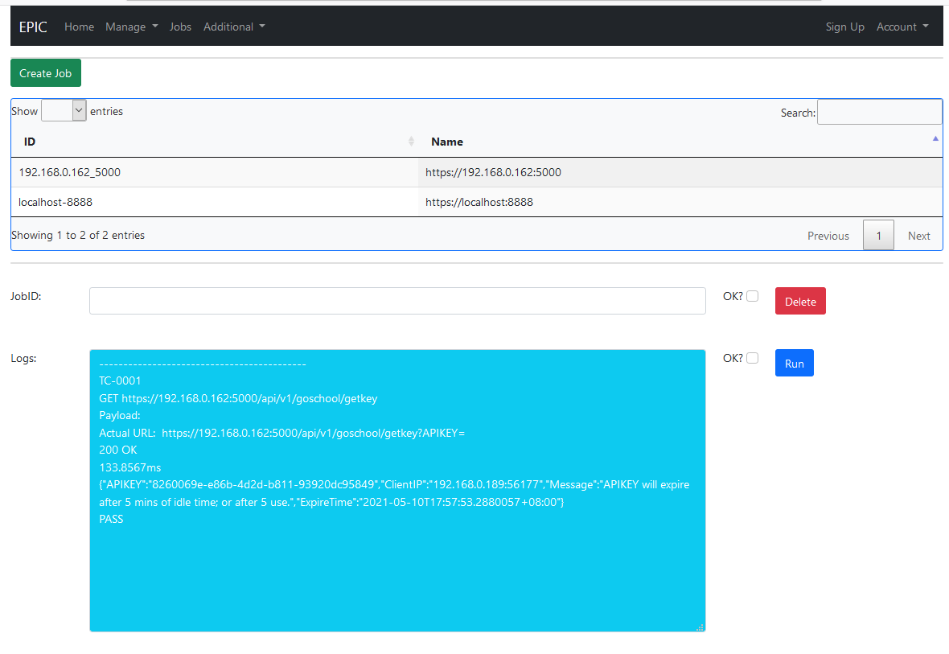
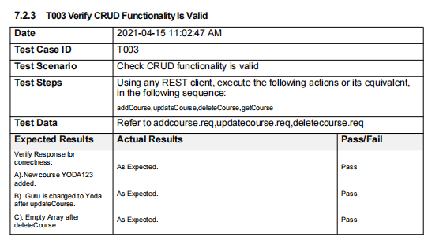
Conclusion
Notes:
end of presentation, but just a beginning
from manual tests till just a few weeks ago, with the microservices project, we now had scriptable console test, and today we hav a web based test system. Epic is just beginning

Slide 53
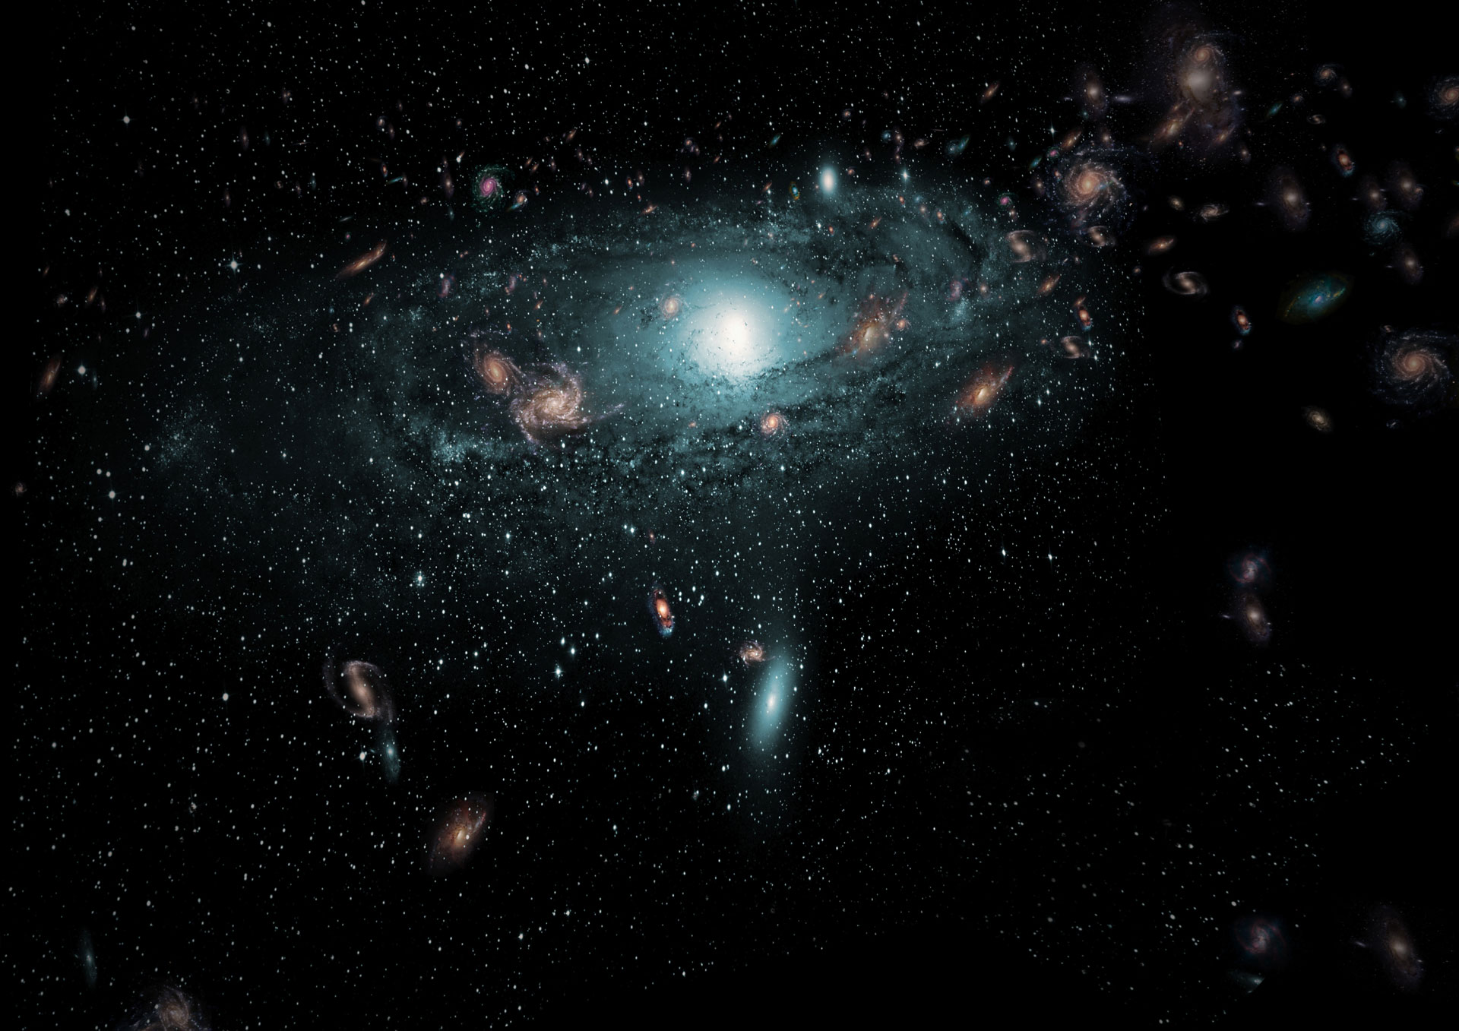
Conclusion
API-T-DROID
Is
A
Potential
Force Multiplier
to help
Devs, QAs
& Entreprise
scale
Productivity
and
Quality.

Slide 54
Credits
Special thanks to all the people who made the course meaningful:
Our ‘Chers’
Tribe Team
Shopee Sponsor
Fellow Students

Slide 55

Thanks!
Any Umbrage?
You can find me at
zeonchan@yahoo.com
https://github.com/jiunnhwa/epic

